Slide 1
BANKNOTE AUTHENTICATION
Harnessing Machine Learning for Secure Transactions

Slide 2
WHY?
Financial Implications
Evolution of Counterfeiting
Counterfeit Banknotes
Manual Authentication Challenges
Counterfeit banknotes pose a significant threat in today's financial landscape
Traditional methods of banknote authentication, often reliant on manual inspection, have limitations.
Potential risks associated with fraudulent transactions
Challenging for conventional authentication systems to keep pace.

Slide 3
SOLUTION
BANKNOTE AUTHENTICATOR APP is the cutting-edge solution to counterfeit banknotes.
Why ML model?
Increased Accuracy
Adaptability to Changing Patterns
Automation of Decision-Making
Efficient Handling of Large Datasets
Key Components:
Data Preprocessing: Cleaning and preparing the input data for optimal learning.
Feature Extraction: Identifying relevant features that distinguish between genuine and counterfeit banknotes.
Classification Algorithm: The core algorithm responsible for making accurate predictions.

Slide 4
SOLUTION
App provides a seamless experience for users involved in the authentication process.
The model's compatibility and seamless integration with existing systems.
Model's adaptability to evolving counterfeit strategies
Efficiency of the ML model compared to traditional manual methods
—ROSE CLARK
Dynamic Adaptation
User-Friendly Interface
Integration Capabilities
Efficiency and Speed

Slide 5
DATASET
01
02
03
PROBLEM & SOLUTION
OUR PROCESS
TARGET
Data were extracted from images that were taken from genuine and forged banknote-like specimens.
For digitization, an industrial camera usually used for print inspection was used. The final images have 400x 400 pixels.
Wavelet Transform tool were used to extract features from images.

Slide 6
FEATURES
VENUS
MARS
SATURN
MERCURY
VARIANCE
Variance finds how each pixel varies from the neighboring pixels and classifies them into different regions
KURTOSIS
Kurtosis is a measure of whether the data are heavy-tailed or light-tailed relative to a normal distribution
ENTROPY
Image entropy is a quantity which is used to describe the amount of information which must be coded for, by a compression algorithm
SKEWNESS
Skewness is the measure of the lack of symmetry

Slide 7





PYTHON LIBRARIES
MARS
NEPTUNE
JUPITER
SATURN
It supports the data representation in arrays and mathematical operations on them.
Data structures such as Data Frames are supported by this library for data analysis.
Tools for data visualization and in-depth analysis.
A simple and easy to use library containing various machine learning algorithms.

Slide 8
MODELS
LOGISTIC REGRESSION
RANDOM FORESTS
DECISION TREE
SUPPORT VECTOR MACHINE
ADABOOST

Slide 9
PERFORMANCE METRICS
LOGISTIC REGRESSION
RANDOM FORESTS
SVM
98.96%
98.96%
99.06%

Slide 10
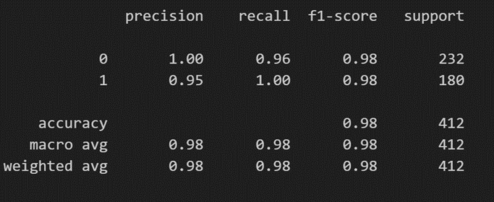

MODEL EVALUATION

Slide 11
THANK YOU

